Slide 1
MLA Formatting
Mary Johnson
Ms. Reisdorf
English 9B
1/23/15
Johnson 1
LT: I can name the elements needed to format a document in MLA and use these elements in my own documents.

Slide 2
When & Why do I need to use MLA
When: Typically used in the liberal arts and
humanities (English, Social Studies, etc.)
Why: Having a common formatting system
makes it easier for readers to read and
navigate through your work.

Slide 3
MLA Checklist: (write this down)
⏩ Header
⏩ First and Last Name
⏩ Teacher’s Name
⏩ Name of Class
⏩ Date
⏩ Page #s W/ Last Name
⏩ Correct Font
⏩ Size 12
⏩ Times New Roman/Arial
⏩ Double Space & One Inch Margins
Mary Johnson
Ms. Reisdorf
English 9B
1/23/15
Reisdorf 1

Slide 4
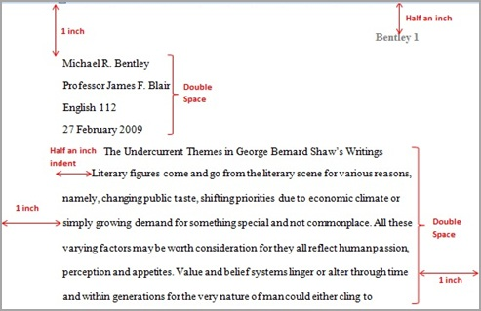
Example:
How to format document in Google Docs

Slide 5
Parenthetical Citations
When using textual evidence, you must cite it with an in-text parenthetical citation.
Requirements:
Parenthesis
Page Number
Period on OUTSIDE of citation.
The author claims that dogs have been studied for a long time, “For decades, scientists have been studying ‘social cognition’ in dogs” (1).

Slide 6
Part 3- Write a Well-Written Paragraph
Directions: Now that you have identified the main idea, supporting details (textual evidence), and know how to cite your evidence, you will write a paragraph that analyzes the main idea of the assignment.
Requirements:
“Format” your document in MLA (Hand-written)
Use at least three pieces of textual evidence
Cite your evidence using in-text parenthetical citations
Staple to graphic organizer and turn in

